Slide 1
★ Concepts of CHAT Session 1 
Action, Behaviour and Consciousness
Mind & Matter?
1/6

Slide 2
Concepts of CHAT Session 1
Consciousness
★
Physiology
Behaviour
Consciousness is the totality of the subjective processes of a human being which mediate between a person’s physiology and their behaviour.
2/6

Slide 3
Concepts of CHAT Session 1
Behaviour
stimulus
reaction
?
Behaviourism
Behaviour is the purely objective aspect of activity, excluding any reference to consciousness
3/6

Slide 4
Concepts of CHAT Session 1
Action
Actions are what a person does - the main units of human life.
4/6

Slide 5
Concepts of CHAT Session 1
Actions
consciousness
behaviour
An action is a (prior?) unity of consciousness and behaviour.
5/6

Slide 6
Concepts of CHAT Session 1
Actions
An action is directed towards an object (goal) which does not coincide with its motive.
6/6

Slide 7
Concepts of CHAT Session 1
Consciousness
Behaviour
Actions

Slide 8
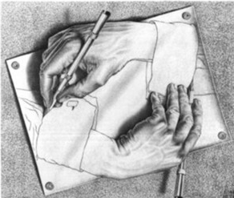
★ Concepts of CHAT Session 2 
Genetic Method Unity and Dichotomy
1/8

Slide 9
Concepts of CHAT Session 2
Genetic Method
The genetic method is the research approach used by Vygotsky to reveal the essential nature of particular psychological functions by
Bringing them into being in an experimental setting, or
Tracing their formation and disintegration in the course of the natural development
2/8

Slide 10
Concepts of CHAT Session 2
Genetic Method
By looking only at the product of a process, or a snapshot, we miss the interconnections and functional relations between apparently separate processes, which make up the whole.
Genetic fallacy & “Just So Stories”
3/8

Slide 11
Concepts of CHAT Session 2
Thinking which is beyond words
True Concepts
Pre-Concepts
Pseudo- Concepts
Inner Speech
Complexes
Development of Speech
Development of Intellect (Concepts)
“Thinking aloud”
Syncretism
Communicative Speech
Potential Concepts
speech
concepts
The Genetic Roots of Thinking & Speech
Pre-Intellectual Speech and Pre-verbal Intelligence
4/8

Slide 12
Concepts of CHAT Session 2
Unity and Dichotomy
dualism
5/8

Slide 13
Concepts of CHAT Session 2
Unity ↔ Distinction
Abstraction
Development
6/8

Slide 14
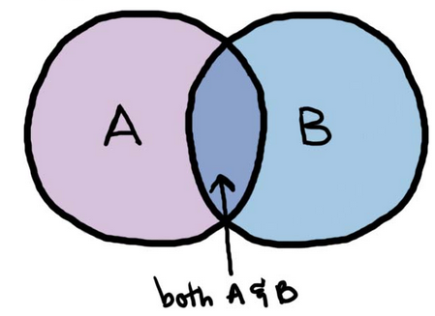
Concepts of CHAT Session 2
Unity ↔ Dichotomy
Union/Intersection
Relation/Identity
For example: person & environment; sound & meaning?
7/8

Slide 15
Concepts of CHAT Session 2
Dualism & Distinction
8/8

Slide 16
Concepts of CHAT Session 2
Genetic Method
Unity
Dualism

Slide 17
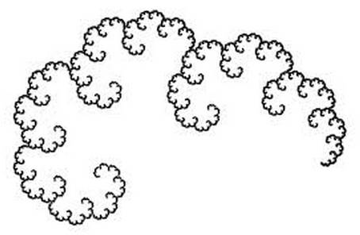
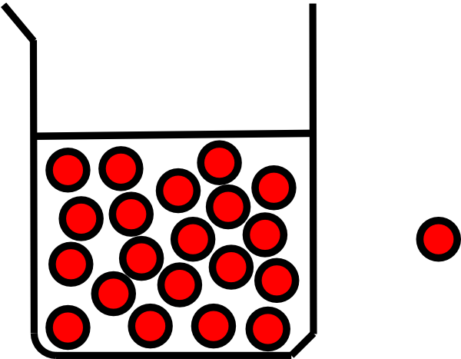
★ Concepts of CHAT Session 3 
Unit and Germ-cell
academia.edu
1/4

Slide 18
Concepts of CHAT Session 3
Unit and Germ-cell
In contrast to the term “element,” the term “unit” designates a product of analysis that possesses all the basic characteristics of the whole. The unit is a vital and irreducible part of the whole.” Vygotsky
The specificity of this [commodity] form consists in that it contains, like a ‘cell’ or embryo, the wealth of more complex, more developed forms of capitalist relations. Ilyenkov
2/4

Slide 19
Concepts of CHAT Session 3
Grundrisse
Abstract Unit ↔ Germ-cell
Analysis
Synthesis
Concrete Reality
Immediate perception
Conceptual reconstruction
3/4

Slide 20
Concepts of CHAT Session 3
Unity and Unit
Unity of A and B = Unit of C
Unit expresses the relation between the whole and the part. Unity expresses the relation between the elements within each part.
4/4
Notes:
Unit of personal development, an Experience=unity of individual & environment; unit of the intellect, a word=unity of sound & meaning; unit of economic life, a commodity=unity of exchange-value & use value; unit of Being, a measure=unity of quantity & quality; unit of social consciousness, a concept=unity of the immediate and mediation; unit of culture, an artefact=unity of material and ideal; unit of behaviour, a reflex=unit of stimulus and response; unit of action, an action=unity of consciousness and behaviour. C.f. Unit of formal logic=proposition; unit of discourse=utterance.

Slide 21
Concepts of CHAT Session 3
Unit of Analysis
Germ Cell
Abstract and Concrete

Slide 22
★ Concepts of CHAT Session 4 
Word-meaning and Artefact-mediated action, Dual stimulation
Sign or tool?
1/7

Slide 23
Concepts of CHAT Session 4
Artefacts
“psychological tools” or “technical tools”
To act on the mind
To act on matter
All artefacts are both material and Ideal
For example: a spoken word; a car; a pointed gun; a train ticket; a telephone.
2/7
Notes:
For example a gun?

Slide 24
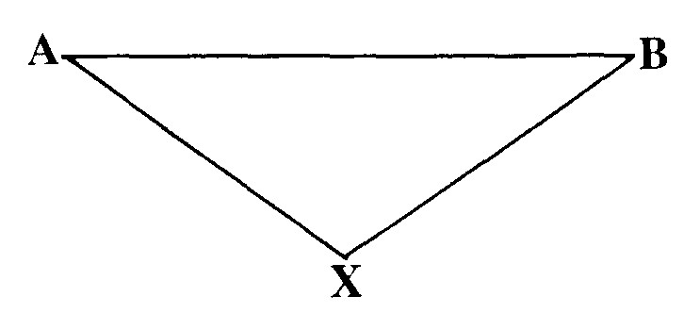
Concepts of CHAT Session 4
Artefact-mediation
Actions and perceptions are both immediate and mediated
3/7

Slide 25
Concepts of CHAT Session 4
Word-meaning or meaningful word
is an action
mediated by a sound
which is meaningful
Word or Action?
4/7

Slide 26
Concepts of CHAT Session 4
Perception is also an action
Reflex Arc?
Dewey
5/7

Slide 27
Concepts of CHAT Session 4
The artefact-mediation of action is the key to the cultural formation of the mind.
“Every function in the cultural development of the child appears on the stage twice, in two planes, first, the social, then the psychological.”
Genetic law of cultural development
6/7

Slide 28
Concepts of CHAT Session 4
Dual Stimulation
Perception
Self-control
Development
Genetic method
7/7

Slide 29
Concepts of CHAT Session 4
Artefact
Artefact-mediation
Dual Stimulation

Slide 30
★ Concepts of CHAT Session 5 
Perezhivanie and Catharsis, Social situation of development, Disability/compensation
Predicaments and Development
1/5

Slide 31
Concepts of CHAT Session 5
Perezhivanie plural, perezhivanija
An intense experience which is worked over, usually with others.
The personality is formed by a series of perezhivanija.
Translation?
2/5

Slide 32
Concepts of CHAT Session 5
Perezhivanie
What do we mean by a “unity of individual and the environment”?
What do we mean by “unity of intellect and affect”?
Personality manifested as forms of collective behaviour, and only later ...
An experience plus catharsis
Freud
3/5

Slide 33
Concepts of CHAT Session 5
Social situation of Development
Predicament
Resolved by adopting a new role and being accepted in that role.
Academia.edu article
4/5

Slide 34
Concepts of CHAT Session 5
Defect/Compensation
Predicament
The defect is in the social relation.
Resolved by development of psychological functioning of individual and adjustment of the environment to meet needs of individual.
5/5

Slide 35
Concepts of CHAT Session 5
Perezhivanija
Catharsis
Social situation of development
Disability/compensation

Slide 36
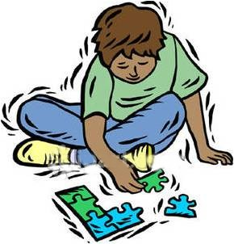
★ Concepts of CHAT Session 6 
The development of Concepts during childhood
A concept is a form of activity
Concepts are formed to solve some problem.
Concepts formed in childhood are generally not true concepts.
1/7

Slide 37
Concepts of CHAT Session 6
The development of Concepts during childhood
Syncretic concepts
Complexes
Pseudoconcepts
———
Potential concepts
Pre-concepts
academia.edu article
1/7

Slide 38
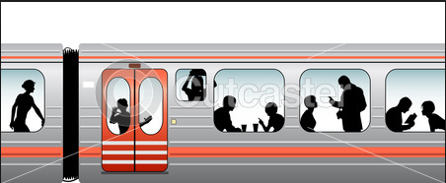
Concepts of CHAT Session 6
Syncretic concepts
Isolate object from background and name it.
Incoherent Heap
Subjective series
“Those there”
2/7

Slide 39
Concepts of CHAT Session 6
Complexes
Abstract a feature and group objects according to the same feature.
Chain complex
Associative complex
Collection complex
Diffuse complex
3/7

Slide 40
Concepts of CHAT Session 6
Complexes
Abstract a feature from object
Hold the feature in consciousness
Synthesise objects by features
Extend complex beyond experience
4/7

Slide 41
Concepts of CHAT Session 6
Pseudoconcepts
to form complex under guidance of others’ word use.
5/7

Slide 42
Concepts of CHAT Session 6
Potential concepts
to isolate objects according to their functional significance
6/7

Slide 43
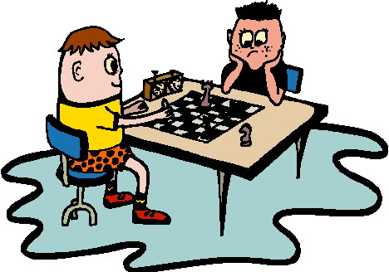
Concepts of CHAT Session 6
Pre-concepts
to reason within a finite set of objects according to rules
7/7

Slide 44
Concepts of CHAT Session 6
Syncretic concepts
Complexes
Pseudoconcepts
Potential concepts
Pre-concepts

Slide 45
★ Concepts of CHAT Session 7 
Spontaneous, True and Actual Concepts
Ideal lines of development, not types of concept
?
1/4

Slide 46
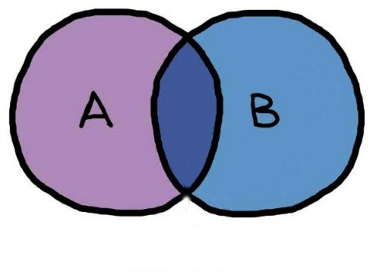
Concepts of CHAT Session 7
Spontaneous Concepts
Recognised by features Acquired interpersonally Unsystematic
pseudoconcept
... Everyday or “empirical” concepts
2/4

Slide 47
Concepts of CHAT Session 7
True Concepts
Part of a system of concepts Culturally transmitted Identify a problem/solution
Scientific, religious, literary concepts ... “book (institutional) learning”
3/4

Slide 48
Concepts of CHAT Session 7
Actual Concepts
training
experience
Have roots in both “institutional” learning and life-experience
4/4

Slide 49
The Emotions
Expression solely internal
Conceptual appraisal
Appraisal of eliciting situation
Expression adaptive to situation
Body Feedback Sensations
Experience Subjective
Internal expression
Self-Regulation
Private expression
Action-readiness
Development of Expression
Development of Action
unconscious expression
Communicative function
expression
Function
Unconscious expression & Undifferentiated feeling

Slide 50
Concepts of CHAT Session 7
Spontaneous concepts
True concepts
Actual concepts
Emotions

Slide 51
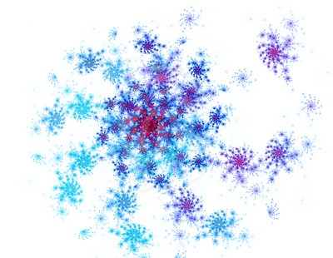
★ Concepts of CHAT Session 8 
Activity: operations, actions and activities
“Activity” is a substance
1/5

Slide 52
Concepts of CHAT Session 8
(Artefact-mediated) Actions
An action is directed towards a goal which does not coincide with its motive.
An action is determined by its goal.
An action is consciously controlled by the subject.
2/5

Slide 53
Concepts of CHAT Session 8
Operation
mishap
mastery
Action
An operation is a fixed pattern of behaviour which can be adapted to conditions.
The subject is not consciously aware or controlling the operation, which is controlled by goal of action.
An operation is determined by its conditions.
3/5

Slide 54
Concepts of CHAT Session 8
Activities
An Activity has an intrinsic motive or object which can only be realised socially, by many actions.
The subject is aware of the motive of the activity.
The activity provides the motive for its actions.
4/5

Slide 55
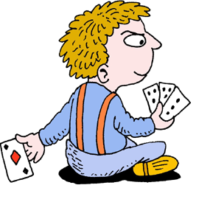
Concepts of CHAT Session 8
Motivation
Personal Sense
Objective Meaning
Psychological
Non-psychological
5/5

Slide 56
Concepts of CHAT Session 8
Operations
Actions
Activities

Slide 57
★ Concepts of CHAT Session 9 
The Object in Leontyev, Engeström and Vygotsky
“Object” is a highly polysemous word!
1/11

Slide 58
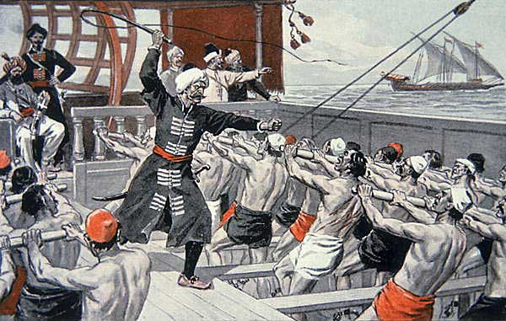
Concepts of CHAT Session 9
The Object for Leontyev
Leontyev’s Activity Theory reveals the structure of motivation
2/11

Slide 59
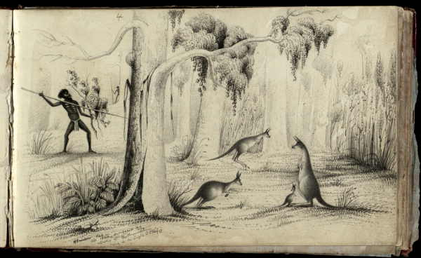
Concepts of CHAT Session 9
The Object for Leontyev
Предмет : ‘the object of activity’ is the imagined and desired objective product or outcome of the activity.
3/11

Slide 60
Concepts of CHAT Session 9
The Object for Leontyev
Need
The Activity
Object
(Gegenstand)
The object meets a social need, which itself arises from activity. But this may differ from the personal sense of the object which motivates an individual’s action.
4/11

Slide 61
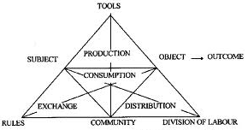
Concepts of CHAT Session 9
The Object for Engeström
Engeström’s Activity Theory, the object is the ‘raw material’ at which the activity is directed and which is transformed into the outcome. The object carries in itself the purpose and motive of the activity.
5/11

Slide 62
Concepts of CHAT Session 9
The Object for Engeström
subject
Object (Arbeitsgegenstand)
tool
Engeström’s Activity Theory does not address how the outcome is/is not intended by individuals, but focuses on actions. Engeström’s outcome may be Leontyev’s object.
6/11

Slide 63
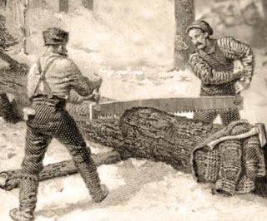
Concepts of CHAT Session 9
Boundary Object
Cooperation between different systems of activity (which “speak different languages” so to speak) is achieved by means of an object which has features recognised by both subjects.
7/11

Slide 64
Concepts of CHAT Session 9
The Object for Vygotsky
For Vygotsky, the object is part of the concept the subject forms of some task or problem. The concept is the form of activity by means of which the object is realised.
8/11

Slide 65
Concepts of CHAT Session 9
The Object for Vygotsky
For Vygotsky, the separate actions relate to the object in the same way word meanings relate to the concept.
9/11

Slide 66
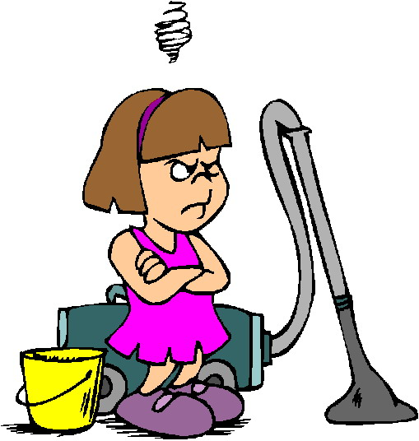
Concepts of CHAT Session 9
The Object for Vygotsky
People form different concepts of the same task according to their social position. The difference is not one of personal sense; it is social.
10/11

Slide 67
Concepts of CHAT Session 9
For example: an encounter with a dangerous bear
A subject will form a different concept according to:
Social position
Available means
11/11

Slide 68
Concepts of CHAT Session 9
The Object for A. N. Leontyev
The Object for Yrjö Engeström
The Object for Lev Vygotsky

Slide 69
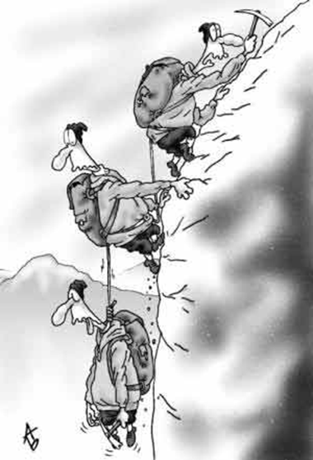
★ Concepts of CHAT Session 10 
“Project” is a unit of social life
A project is an activity.
1/5

Slide 70
Concepts of CHAT Session 10
The object of a project is the concept it has of itself
A project is a process of concept formation.
2/5

Slide 71
Concepts of CHAT Session 10
Projects are units of social life
Social life is a large number of projects interacting with one another.
3/5

Slide 72
Concepts of CHAT Session 10
The Project is a practice with an object
The Project provides the “frame” or context in which the judgments are made (ideology)
4/5

Slide 73
Concepts of CHAT Session 10
Projects collaborate with one another
by colonisation
negotiation
or solidarity
Collaboration includes both conflict and cooperation
5/5

Slide 74
Concepts of CHAT
The End
Thank you

Slide 75
Unit of personal development, an Experience=unity of individual & environment;
Unit of the intellect, a word=unity of sound & meaning;
Unit of economic life, a commodity=unity of exchange-value & use value;
Unit of culture, an artefact=unity of material and ideal;
Unit of behaviour, a reflex=unity of stimulus and response;
Elements disclosed by analysis
Unit of action, an action=unity of consciousness and behaviour;
Unit of language, a sentence=unity of subject and predicate.
Units not dialectically constructed
Unit of formal logic=a proposition;
Unit of discourse=an utterance.

